Slide 1
Comparison of Random Forest and K-Means: Why Random Forest Performs Better - A presentation by Group 7
Dataset Details
FIFA 19 Player Data
- 18,157 players × 41 and interpretability
numeric features (after cleaning)
- Models: Random Forest (supervised) vs. K-Means (unsupervised)
- Goal: Evaluate performance

Slide 2
Random Forest(What We Did)
1
2
3
4
Company Name
Q1 / Month
Year
applied a train/test split with 20% of data for testing and 80% for model training.
Used feature importances and SHAP for interpretability and explanation.
R² on test set = 0.9760 (model.score printed in notebook)
Trained a RandomForestRegressor (n_estimators = 100) on numeric features (excluding Overall and Cluster).
Random Forest (Results & Interpretation)
R² on the test set: 0.9760 (as shown in the notebook output).
Key insight: The model provides clear feature importances, and the SHAP summary reveals how individual features influence predictions.

Slide 3
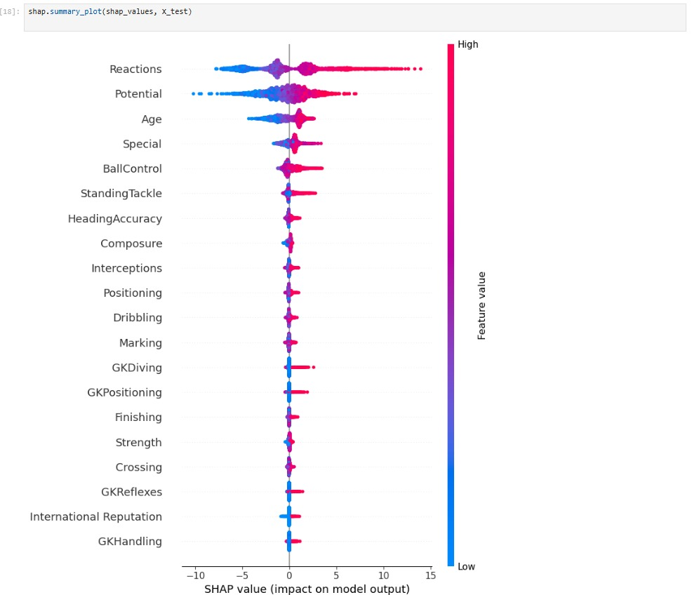
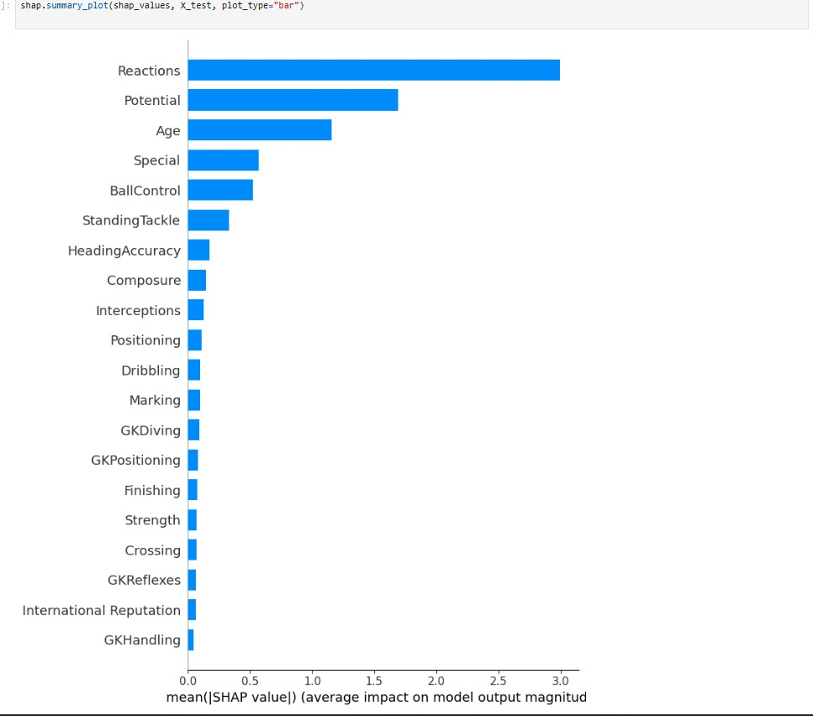
Random Forest (Visualazation)

Slide 4
K-Means (What We Did)
1
2
3
4
Company Name
Q1 / Month
Year
Today’s agenda
Ran K-Means on standardized numeric features (tested multiple k values, selected using the silhouette score).
Reduced dimensions to 2D using PCA for visualization.
Mapped clusters to Simplified_Role groups to calculate pseudo-classification metrics.
Grouped similar players by numeric features

Slide 5
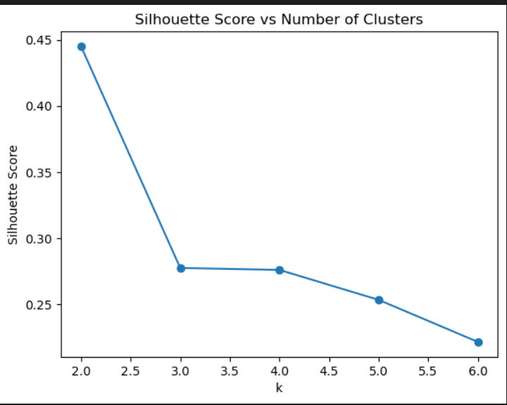
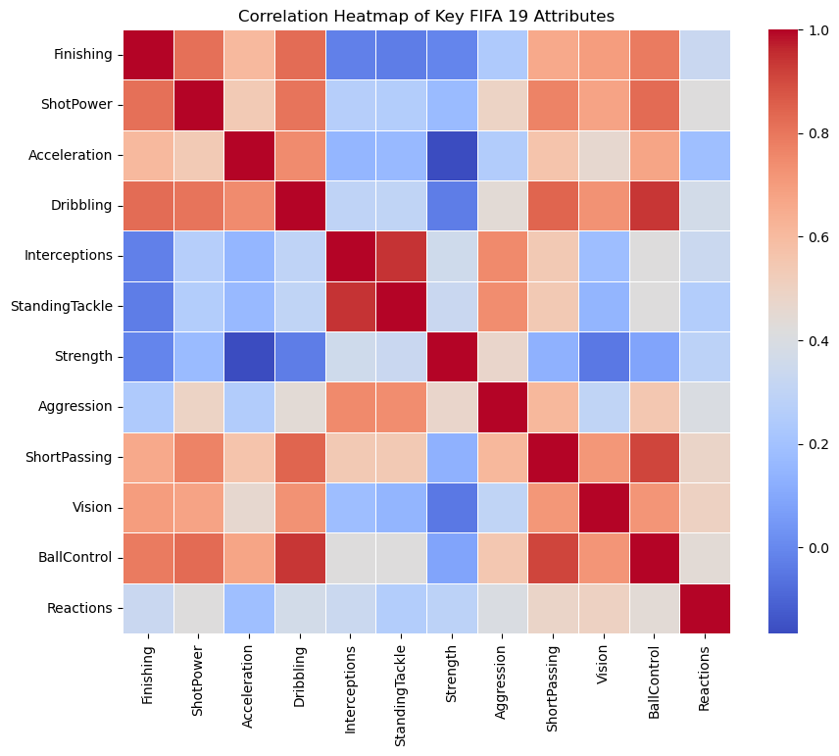
K-Means (Results)
Silhouette score: 0.277 → indicates moderate cluster separation.
Accuracy (cluster → role): 0.523 (52.3%).
Weighted F1-score: 0.469.

Slide 6
Direct Comparison (Between Models) & Explainability Tools
Metric / Method | Random Forest | K-Means (mapped) | Explainability Tools: SHAP and Feature Importance Top Influencing Features: • Overall Rating • Potential • Skill Moves • International Reputation SHAP shows how features contribute to player ratings, improving interpretability and trust.
Predictive Power | R² = 0.976 | Accuracy = 0.523
Interpretability | Feature importances + SHAP | Cluster centroids
Best Use Case | Predict labels | Explore structure

Slide 7
Key Insights & Conclusion
Why Random Forest Wins:
• Learns from labelled data → better predictive accuracy
• Robust to noise and feature interactions
• Provides explainable results (SHAP, feature importance)
Takeaway:
K-Means is great for exploratory analysis, but Random Forest provides reliable predictions and insights.
Thank You!

